Slide 1
Speech Bubble
The next generation of language learning and speech suggestion wearables
Amrutha Gujjar
Arielle Menn
Mary Edwards
Sachin Bharati

Slide 2
Overall Problem

Slide 3

In today’s globalized world, we meet people from all over the world, people from many different countries who speak many different languages.

Slide 4

Between accents, colloquial phrases, and slang, it’s all too easy to become Lost In Translation.

Slide 5
We aim to tackle the problem of communication difficulties head on.

Slide 6
Research Plan

Slide 7
Goal
Help people feel more at ease during their conversations by providing them aid along the way
Provide regular, reliable and honest feedback, and help track progress in achieving greater conversational fluency

Slide 8
Our Idea
A conversational language support tool.

Slide 9
Research Goals
Exploring and learning about our various target groups and participants, and how they felt about the problem we were trying to address
Primary Audience: people trying to improve their conversational English abilities and understand colloquial phrases and terms
Research Approach: Interviews!
Better understanding of how non-native English speakers used conversational English in their everyday lives, whether that be in the realm of social, or professional, or educational settings.

Slide 10
Who We Talked To
Professionals who are interested in having a more technical vocabulary and achieving a professional tone in the workplace.
Students who need to incorporate more advanced vocabulary into their academic projects and papers.
We ultimately decided that our stakeholders are generally non-native English speakers who want to achieve more fluency and clarity in their English skills.
Immigrants who have English as a second language.

Slide 11
What We Heard
Pronunciation, understanding and using common phrases, and understanding other accents
The main trend that emerged was a demand for immediate feedback that did not interfere with social situations.
Written communication and spoken interactions
Written/formal English vs conversational English

Slide 12
Earpiece Wearable
Consistent feedback loop and immediate feedback through the watch interface
Smart Watch
Smart Phone
Able to detect parts of a conversation that may be poorly phrased or difficult to understand, using our sophisticated natural language processing algorithms
More detailed reports sent to a smartphone or laptop

Slide 13
Trends we saw
Frustration with finding a word
Talking around a concept
Understanding idiomatic phrases
Understanding quick, slurred, or accented speech
Missing bits of class material or information at a meeting
Desire for friendly feedback
Anxiety surrounding professionalism in written communications like emails

Slide 14
Tasks

Slide 15
6 Tasks
Understanding someone with an accent
Slowing down fast speech
Remembering colloquial phrases
Writing a professional email
Recalling a word or term
Editing a paper or professional document

Slide 16
Discussion about Written vs Verbal Tasks, Focus on Verbal: 4 Tasks
Written task problem space is already addressed.
Memory for phrases or words used recently was in high demand.
We felt more drawn toward these tasks because we felt that help with, and tracking of, verbal colloquial interactions was a much less well-addressed problem space than that of written English.
Working with a live conversation in an intuitive and non-interruptive way would be a challenge.
Notes:
make the greatest difference in this area.

Slide 17
Designs

Slide 18
Designs and motivation
Task 1: meeting someone with an accent. Task 2: Slowing down what somebody is saying so they are easier to understand.
Narrowing 6 tasks to 4 tasks for each design was the goal.
Each design had 4 tasks, but not all designs had the same 4 tasks.
Task 3: Remembering how to use common phrases. Task 4: Writing an email to a boss asking for a raise.
Task 5: Wishing after a conversation that you had known or remembered a word to better describe yourself.
Notes:
We leaned more towards verbal tasks than written tasks. The verbal tasks provided for instant feedback rather than delayed. However, we also like the idea of providing automated email correction/ a suped-up grammar checker, as well as a conversational diary for reflection of previous conversations.

Slide 19
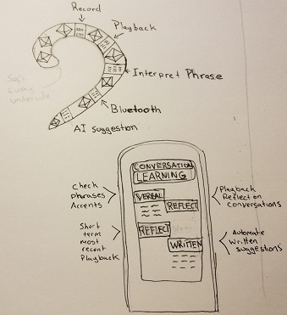
Design 1: Wearable Decorative Earpiece/Conversational learning App.
Supports audio recording/playback
Allows for slowing down speech
Checking of common phrases
Reflection on prior conversations
Additional application integration

Slide 20
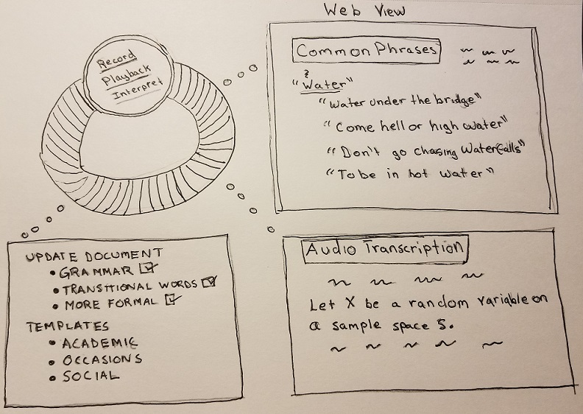
Design 2: Wearable Smart Watch with Conversational learning Application
Smartwatch Adaptation
Similar tasks as design 1.
This one is more accessible and inconspicuous.
Notes:
make the greatest difference in this area.

Slide 21
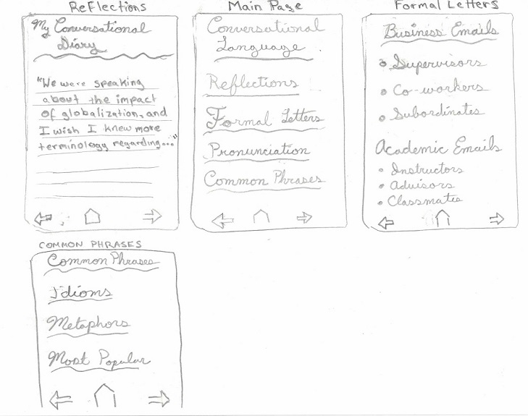
Design 3: Web application/Mobile Application
A simple web application/mobile application
Allows interaction at a leisurely pace.
Reflecting on previous conversations.
Pronunciation support.
Understanding common phrases.
Writing formal letters.

Slide 22
Two Tasks for Main Design
Our research and feedback led us to ultimately center around two tasks:
Slowing down speech so it is easier to understand
Remembering how to use common phrases
Notes:
These were the two tasks we were choosing going forward with our design.

Slide 23
Slowing Down Speech
Focus on instant or queued replay of specific audio bites
This task will help people understand rapid speech, a commonly cited challenge.
Prevents any miscommunication from the person based off of misunderstood information

Slide 24
Remembering the Usage of Common Phrases
Wanted to give customers peace of mind about their communication to others.
This task focuses on clear communication from the person and incorporates a tracking element.
People can self check vocabulary usage and store new words or phrases they’ll use again soon.
Notes:
make the greatest difference in this area.

Slide 25
Tasks selected for Design Storyboards
Task 1: Slowing down speech.
Task 2: Remembering common phrases.
During critiques, parsing of conversational data was popular.
Help with, and tracking of, verbal interactions is a much less thoroughly addressed problem space than written English.
Email clients and verbal AI software existed in the problem space already.

Slide 26
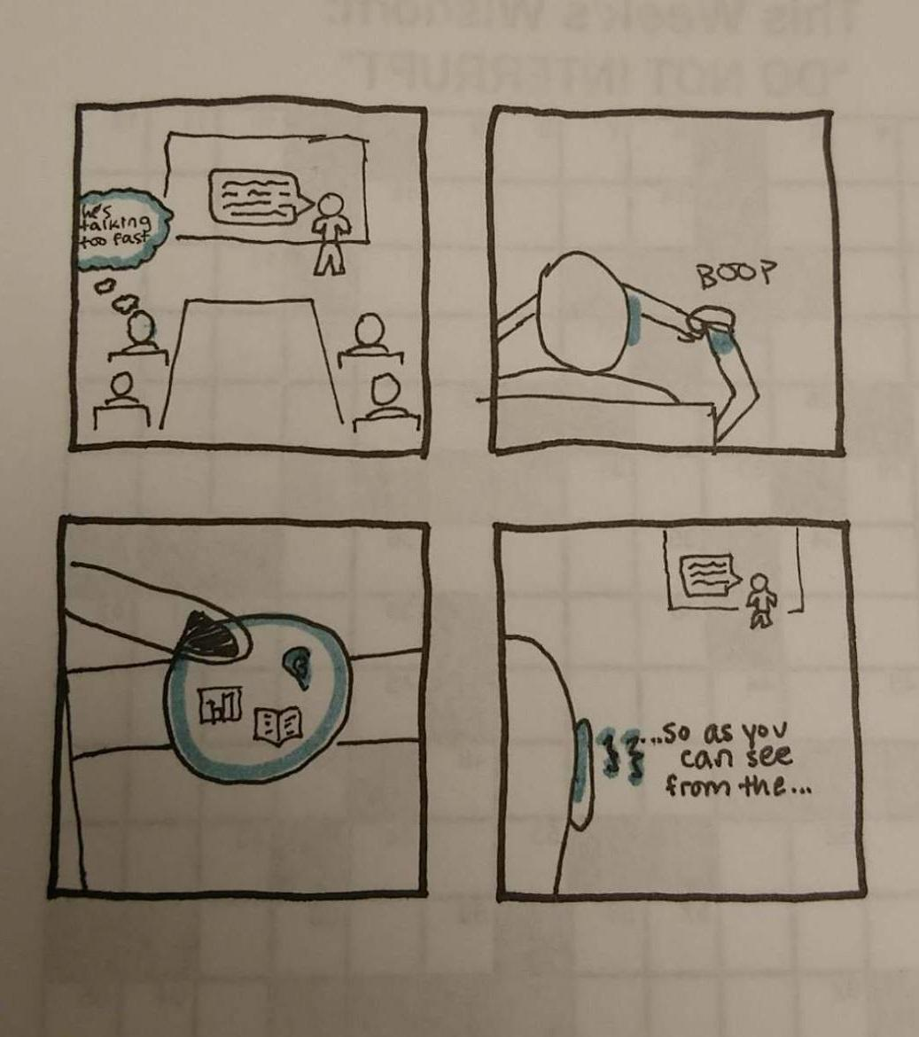
The Speaker was speaking too quickly.
I wish I had a way to replay what they just said...
Oh that’s right, I do!
Thanks Speech Bubble!

Slide 27
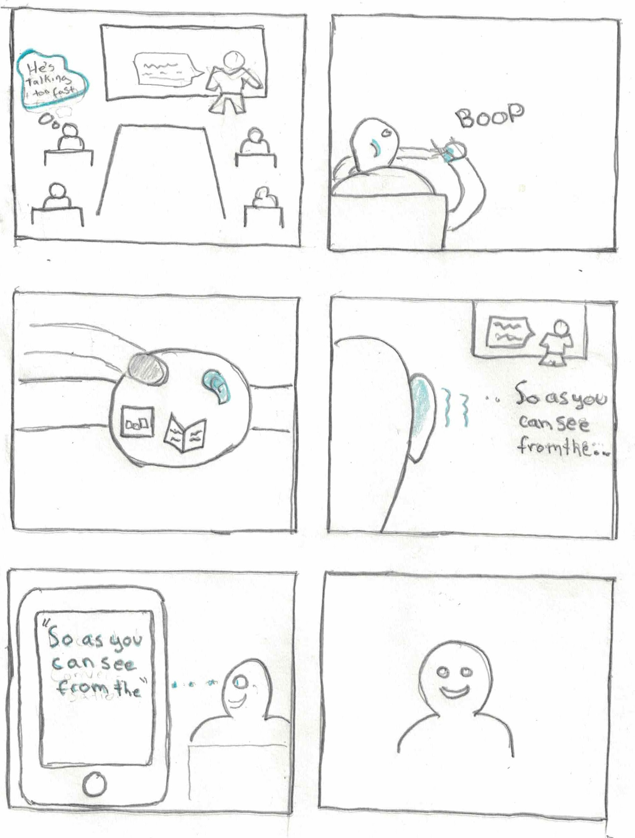
Adds more to earlier storyboard.
Web Application interface.
Includes increased data storage and access.

Slide 28
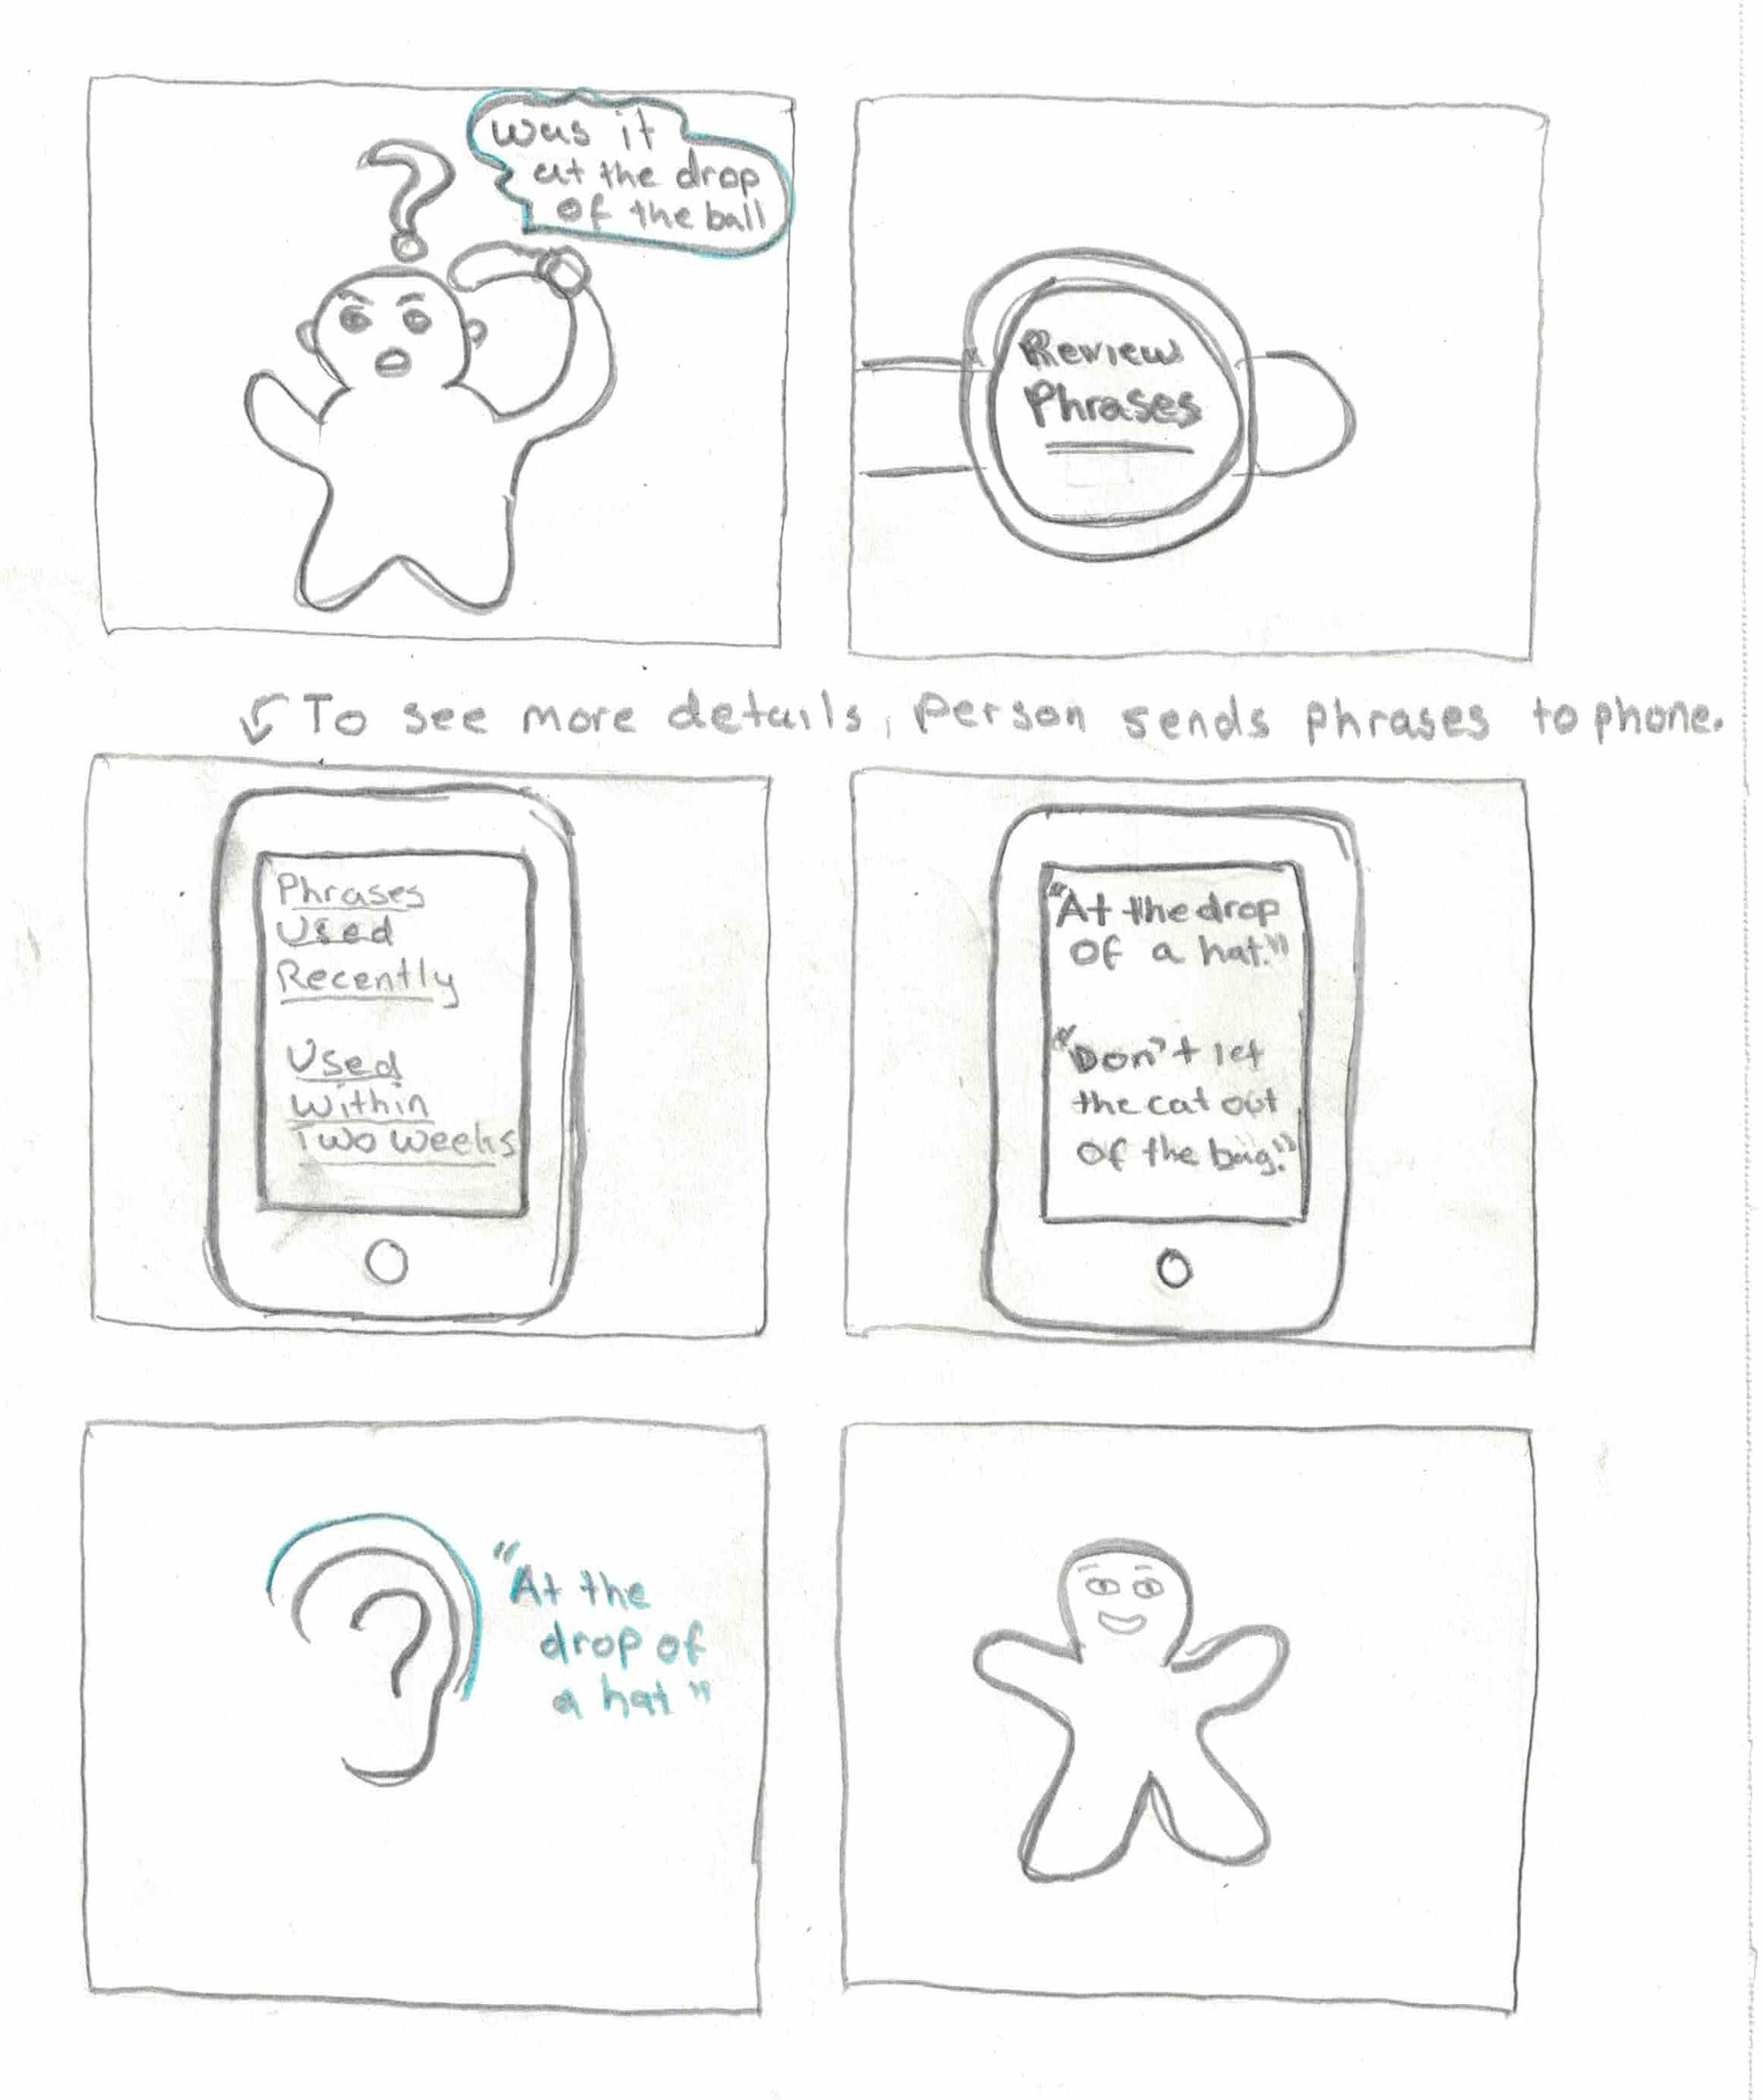
New English Speakers may have difficulties with common phrases.
We can remember for them and give reminders.

Slide 29
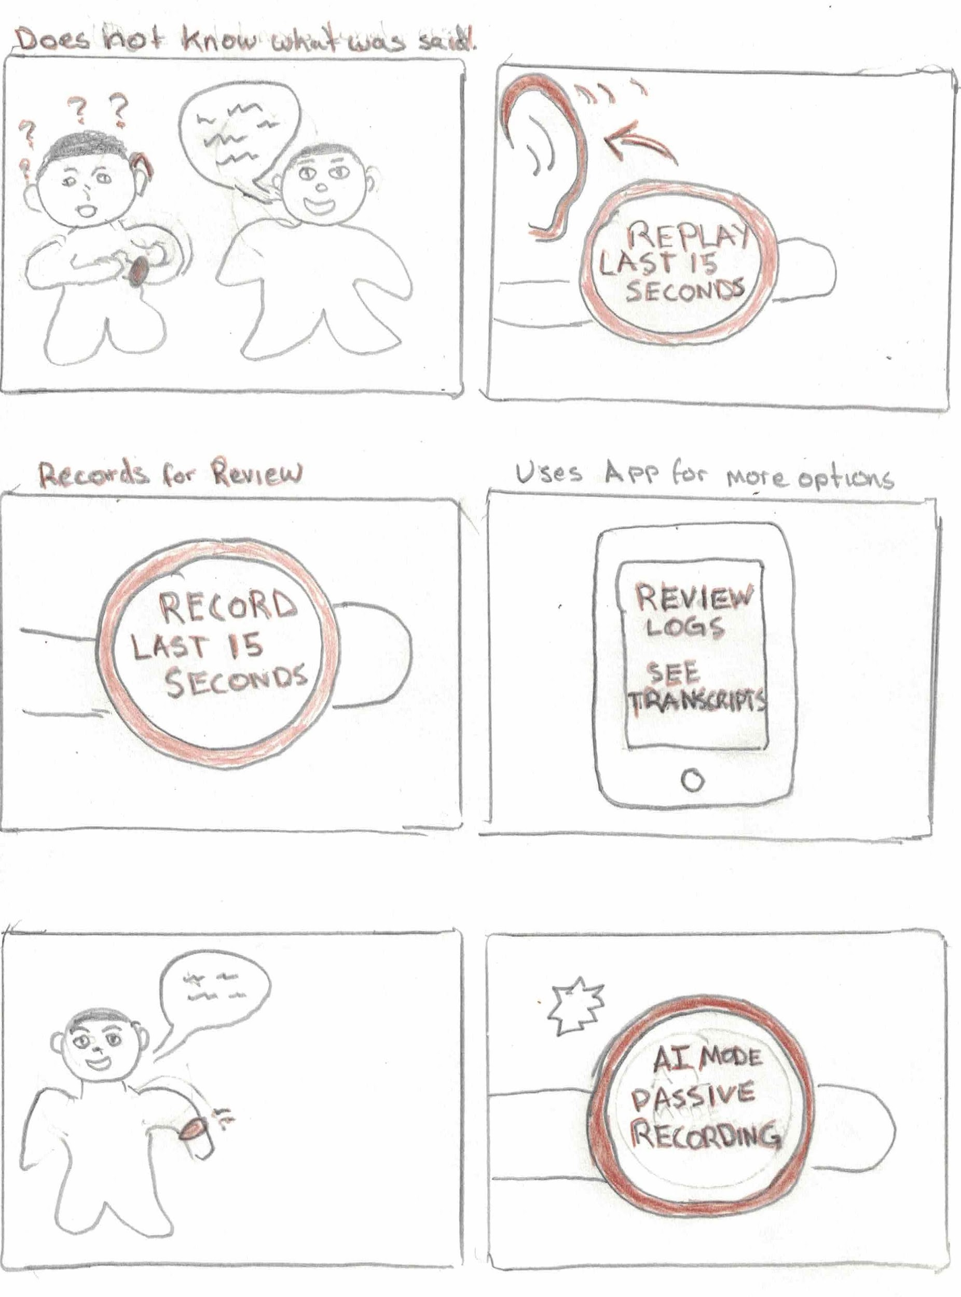
We evolved our storyboard to focus more on the interface rather than the object.
Quick playback access to last 15 seconds, or access of long-term data through an integrated app.

Slide 30
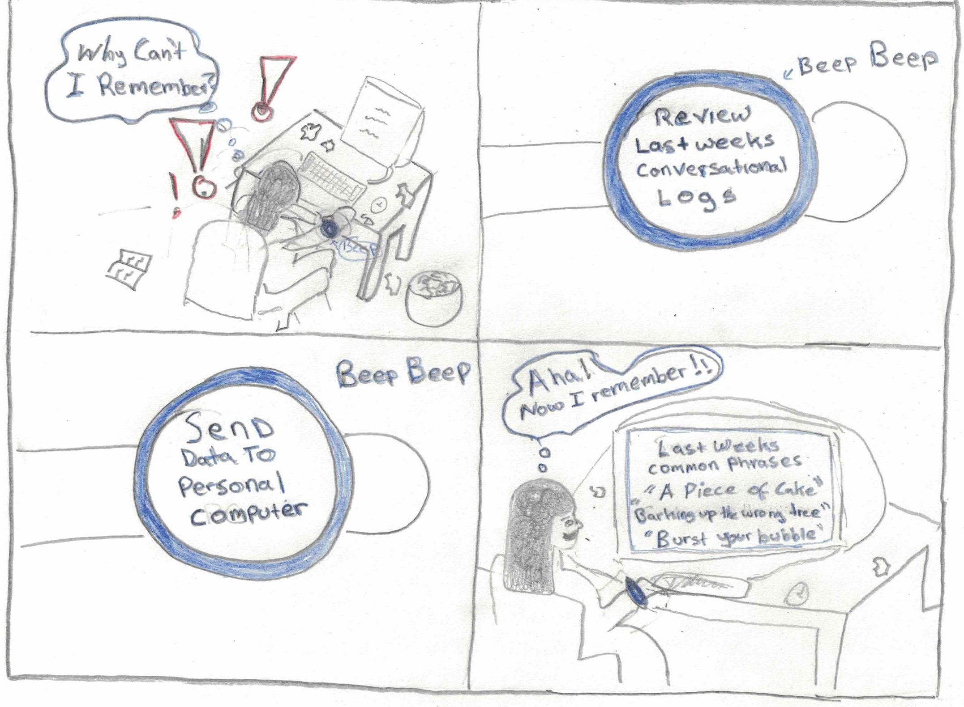
We can support real time social conversations and also logs/prior lookup.
Notes:
Remembering common phrases can be quite a frustrating experience. It can happen real time during social conversations and also later when you realize you just can’t remember that phrase! Our interface will support both.

Slide 31
In Short, What We’ve Learned
Notes:
To focus more on verbal versus written tasks, as there was more positive feedback in research groups on this.
Taking the idea of an interface rather than an object to the next level/ expanding the capability of vocal AI tech to interpret less literal commands from the user.

Slide 32
Thank You!

